Slide 1
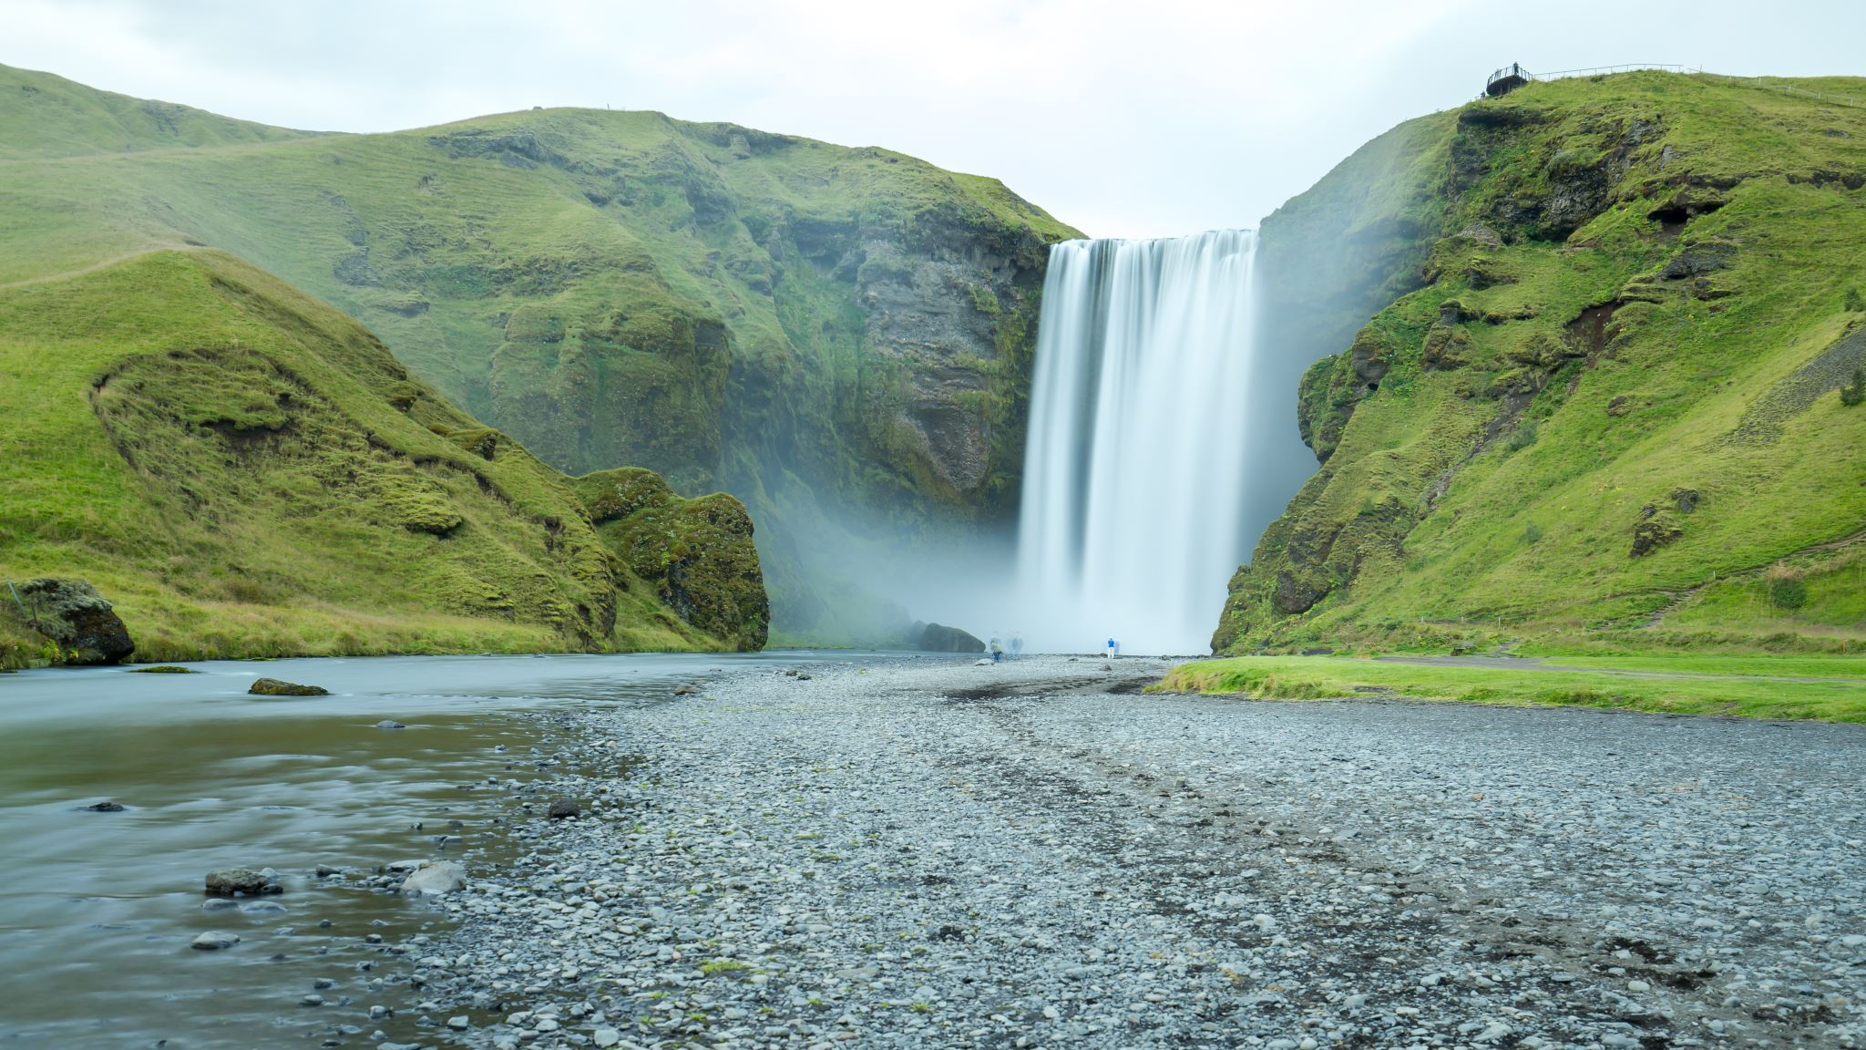
Hope from around the Circuit

Slide 2
ROMANS CH 8 VS 38 & 39
³⁸ For I am convinced that neither death nor life, neither angels nor demons, neither the present nor the future, nor any powers, ³⁹ neither height nor depth, nor anything else in all creation, will be able to separate us from the love of God that is in Christ Jesus our Lord.

Slide 3

Prayer
Lord, you know the way ahead for us.
If there are challenges to face,
May we trust in your Word and your steadfast love.
If we grow weary and begin to lose our hope,
If doubt creeps in, May we remember your promise to be with us always.
If our minds become overloaded with anxious thoughts,
May we know the mind of Christ which you offer to us.

Slide 4

May we discover that it is in our weakness that we find your strength. If it seems that life is uphill all the way And all we can see are obstacles, May we find rest in the knowledge that you hold us in your hands. Lord, as the days and weeks unfold, May we recognise your hand in our life and your provision for us. Thank you Lord. Amen.

Slide 5
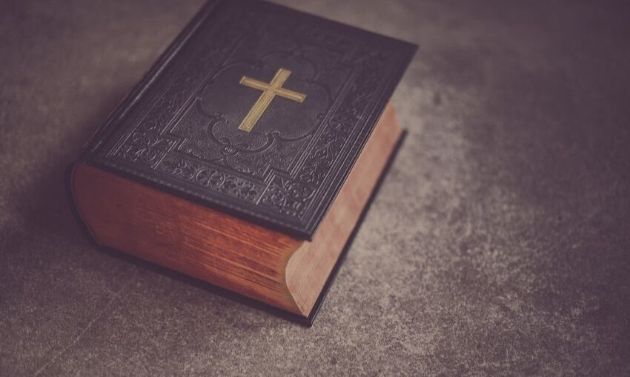
Joshua 1: 9 'Remember that I commanded you to be strong and brave. Don't be afraid, because the Lord your God will be with you everywhere you go.'

Slide 6
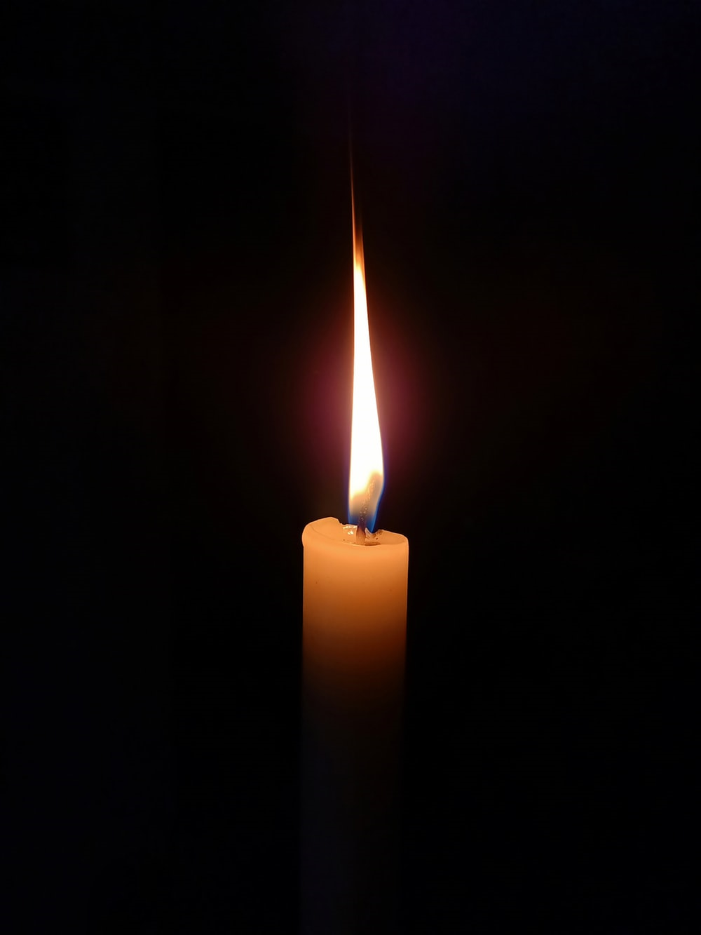
Keep us, good Lord under the shadow of your mercy in this time of uncertainty and distress.
Sustain and support the anxious and fearful, and lift up all who are brought low; that we may rejoice in your comfort knowing that nothing can separate us from your love in Christ Jesus our Lord.

Slide 7

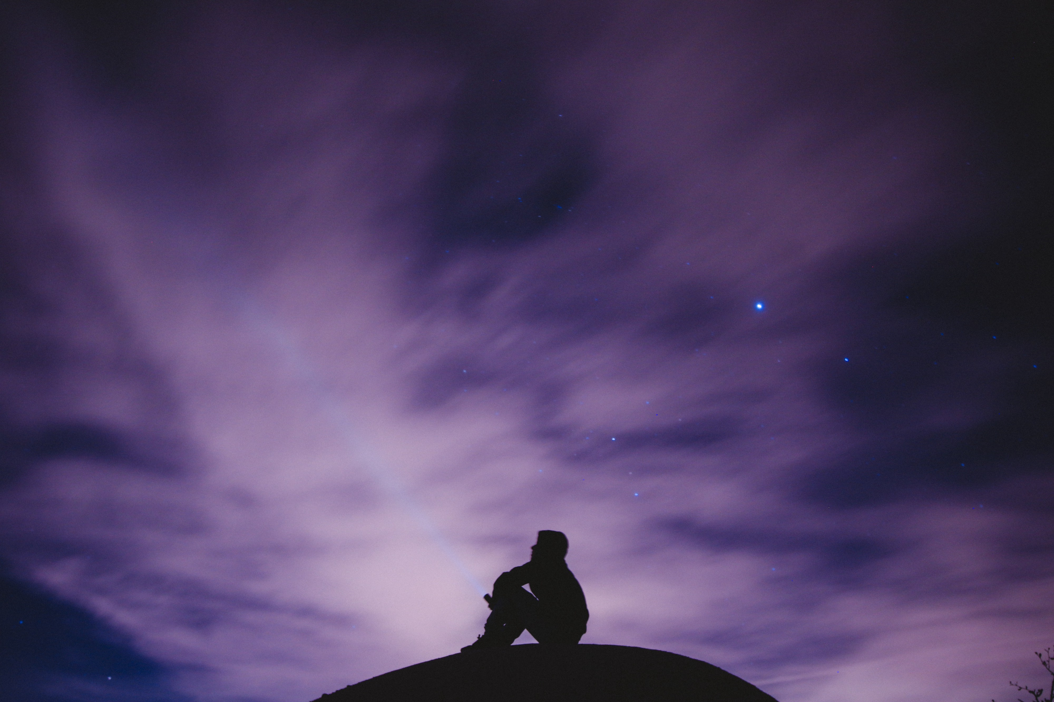
From a book of Private prayer
Show me, loving God,
how to approach my sense of being alone
and cut off,
so that it may not be a condition to be dreaded,
but rather seen as a means
to closer dependence on you.
Let my soul learn in solitude the lesson of your presence.

Slide 8
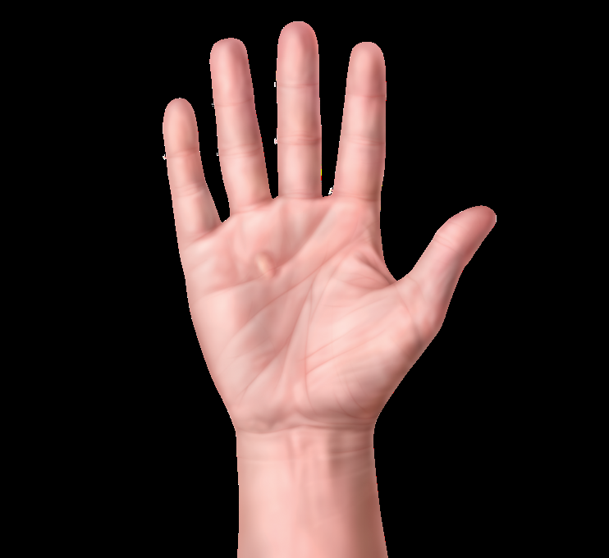
This is a very simple way to pray to cover most things based on your hand as a guide.
Firstly hold up your thumb. This represents friends and family (people who are close to you). These are often the first people you think about when you pray. Give thanks to God and ask his protection on your parents or guardians, grandparents, brothers and sisters, friends and classmates.
Next, hold up your pointing finger. These are people who point the way in our lives. Teachers, ministers, BB leaders. We offer God thanks for them and ask him to help them in their leadership work.
Next your tall finger (or at least it is for most people), hold it up in a nice way. These are people in authority. Leaders, our prime minister and government, police and services, especially at this time those concerned with hospitals etc.
Hold up the next finger. It is sometimes called our ring finger. This is people who at this time are weak or ill or living in poverty sleeping rough etc. refugee’s, people either in this country or abroad. We pray Jesus will give them healing and new strength.
Right last of all, hold up your little finger. This represents you your own needs. You are important to God too, he wants to know your own needs, especially as we have in this prayer put others needs first before your own. Pray for growth in body mind and spirit.
Amen.

Slide 9
Material provided by Maureen Ownsworth, Ruth Fitch, Kate Horrix, Clare Pickering, Don Spooner Caroline Barratt, Barbara Glasson.

